Slide 1


Statistical Analysis

Slide 2
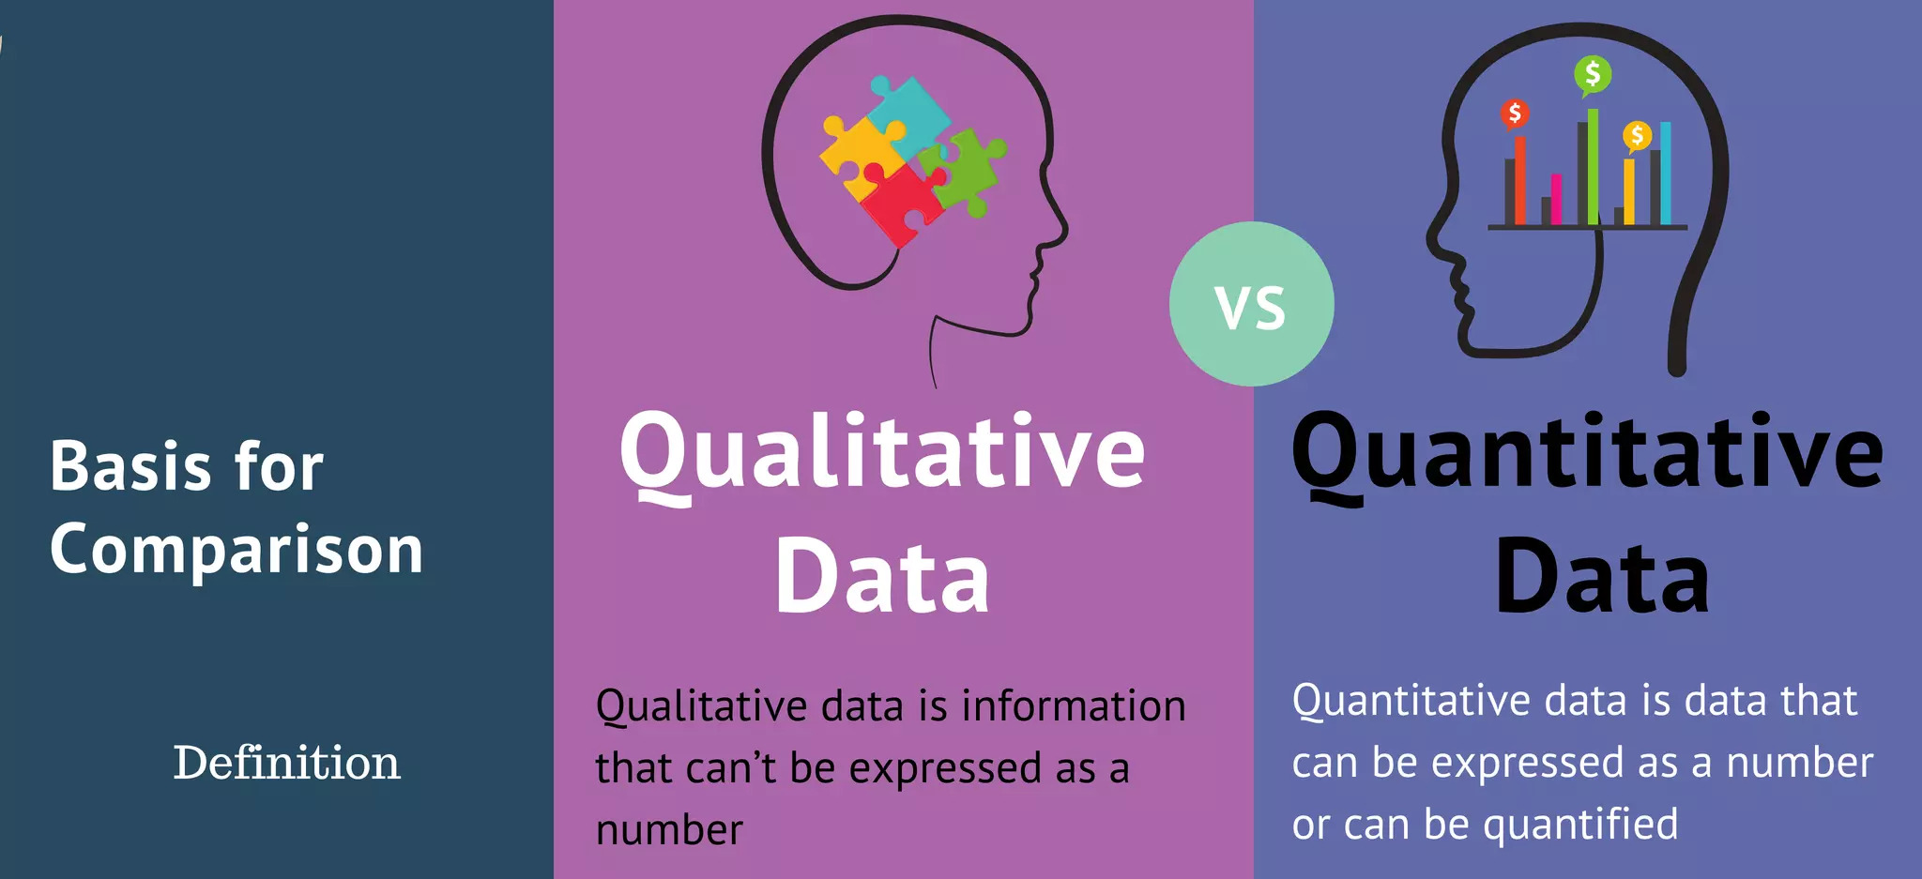
Statistics fundamentals

Slide 3
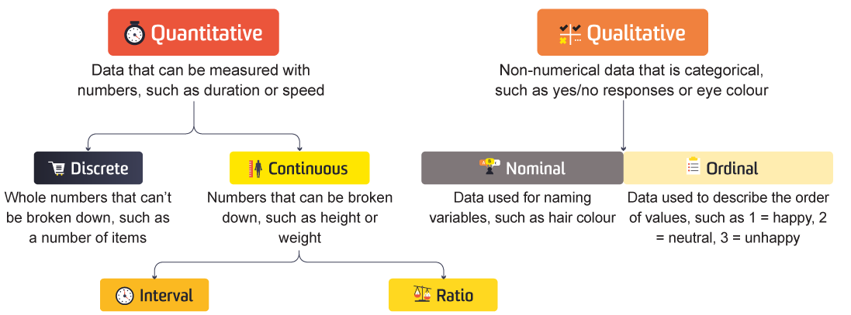
Statistics fundamentals
Data Types

Slide 4
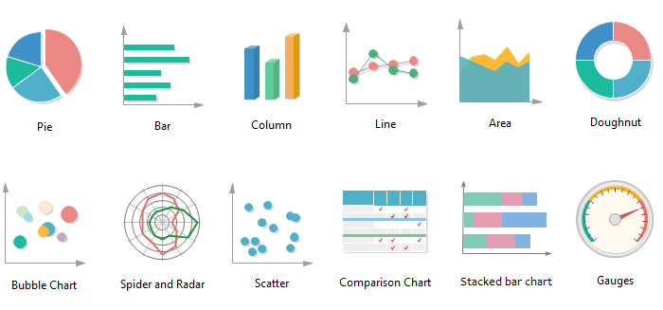
Statistics fundamentals
Most Common Data Visualization Types

Slide 5

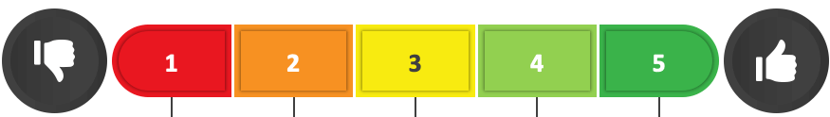
Statistics fundamentals
Likert Scale
Strongly
Disagree
Disagree
Neutral
Agree
Strongly
Agree
Likert scale is a psychometric response scale used in questionnaires
to measure opinions, attitudes, or behaviors.

Slide 6
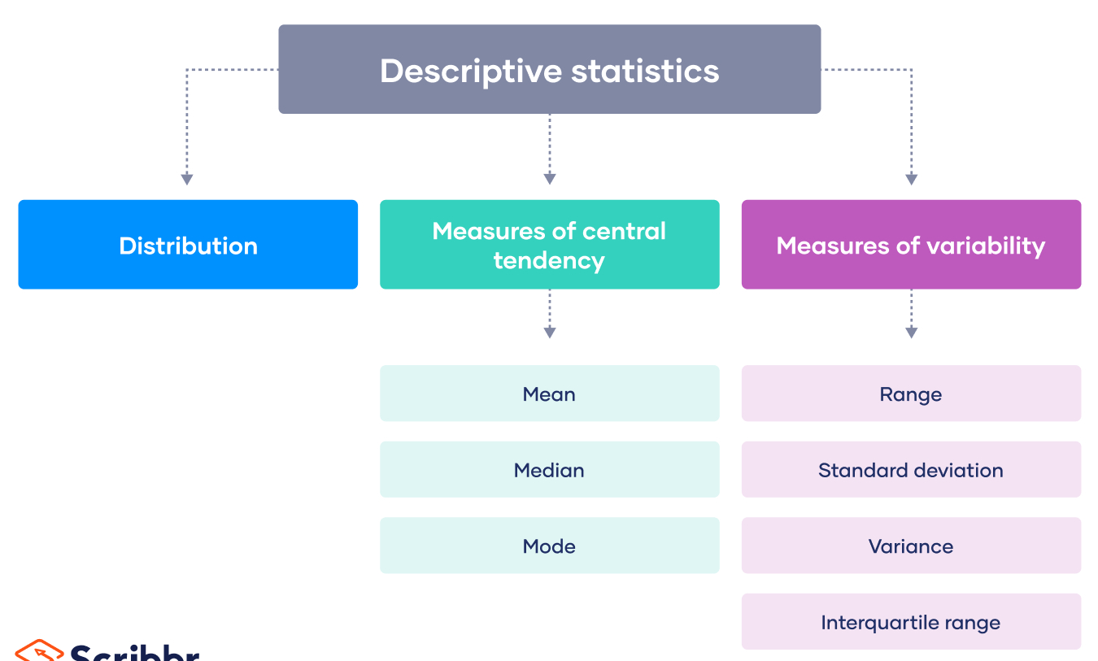
Statistics fundamentals

Slide 7
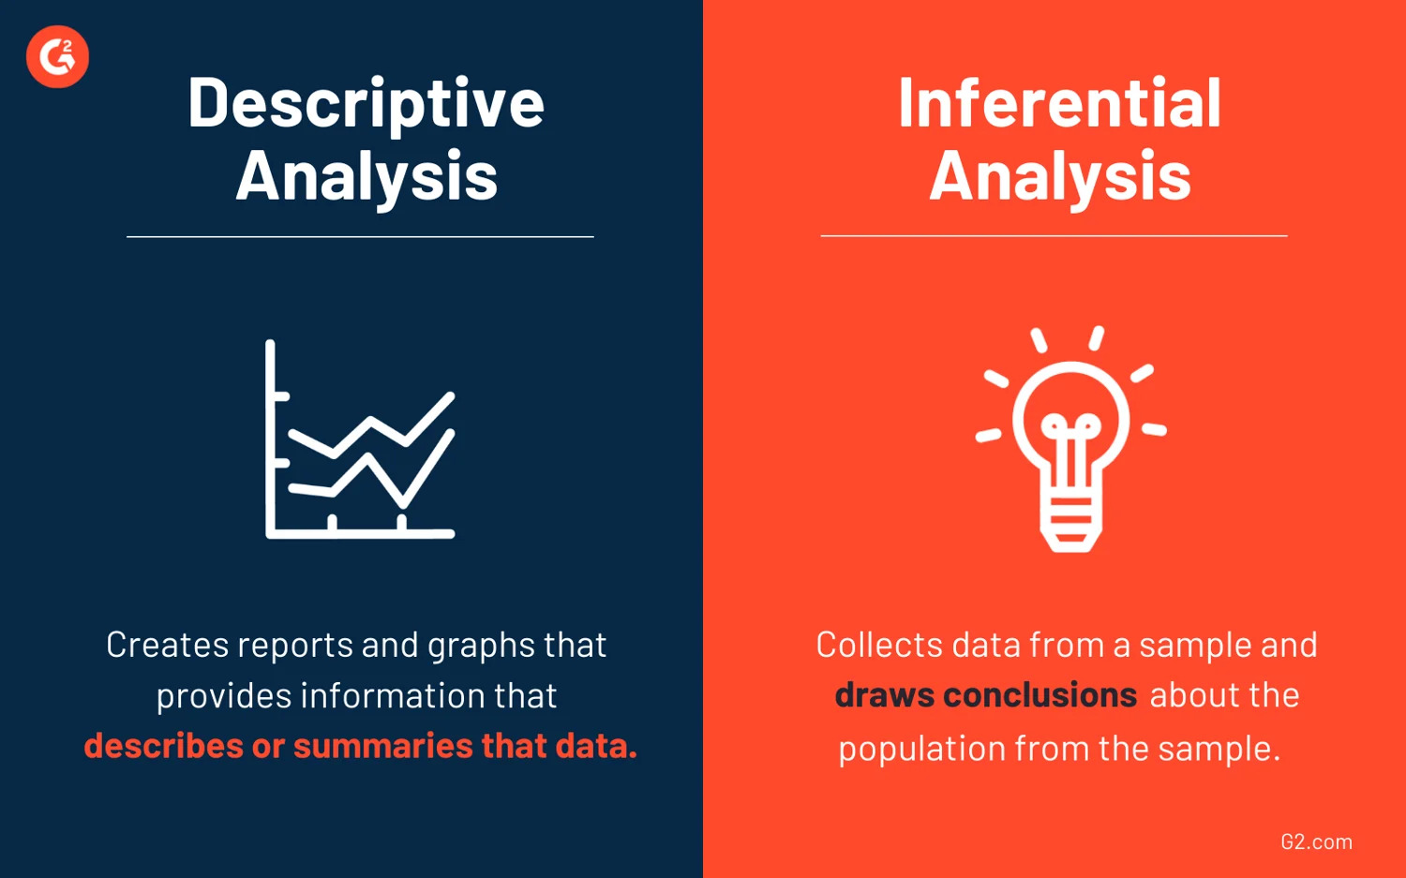


Statistics fundamentals
Creates reports and graphs that provides infos that describes or summaries that data.
Draw conclusions from a data to predict and generalize results for a larger population.

Slide 8
Statistics fundamentals
Inferential Statistics
Normality Testing
Comparing Means
Testing for Differences
Correlation Analysis
T & Z Tests
Khi-2 Test

Slide 9
Data Processing

Slide 10
Data analysis

Slide 11


DOCUMENTATION
Create a report and presentation
to document the analysis.

